Slide 1


ADDITION & SUBTRACTION QUIZ
1.Nur Sabrina Bt Mohd Ikhwan Azali Nanda WIF 170127
2.Jeremy Nathan A/L Pakea Nathan WIF170060
3.Mohd. Luqman Hakim bin Mohd. Sykry WIF170088
4.Haritharan Nair a/l Paramasivam WIF170055
5.Ganesh A/L Manickam WIF170050
6.Kelued Abdella WIF170706

Slide 2

INTRODUCTION
Alzheimer's is a type of dementia that causes problems with memory, thinking and behavior. In order to battle this progressive disease, we have decided to come up with a simple addition & subtraction quiz to help slow down the progress of this disease.

Slide 3
OBJECTIVES
To aid in slowing down the progress of Alzheimer’s disease through our quiz.
To help raise awareness among UM students about Alzheimer’s disease.
To shed light on how Alzheimer’s affects the brains hoping that this will lead to a better understanding hence leading to new treatments.

Slide 4

DESIGN

Slide 5
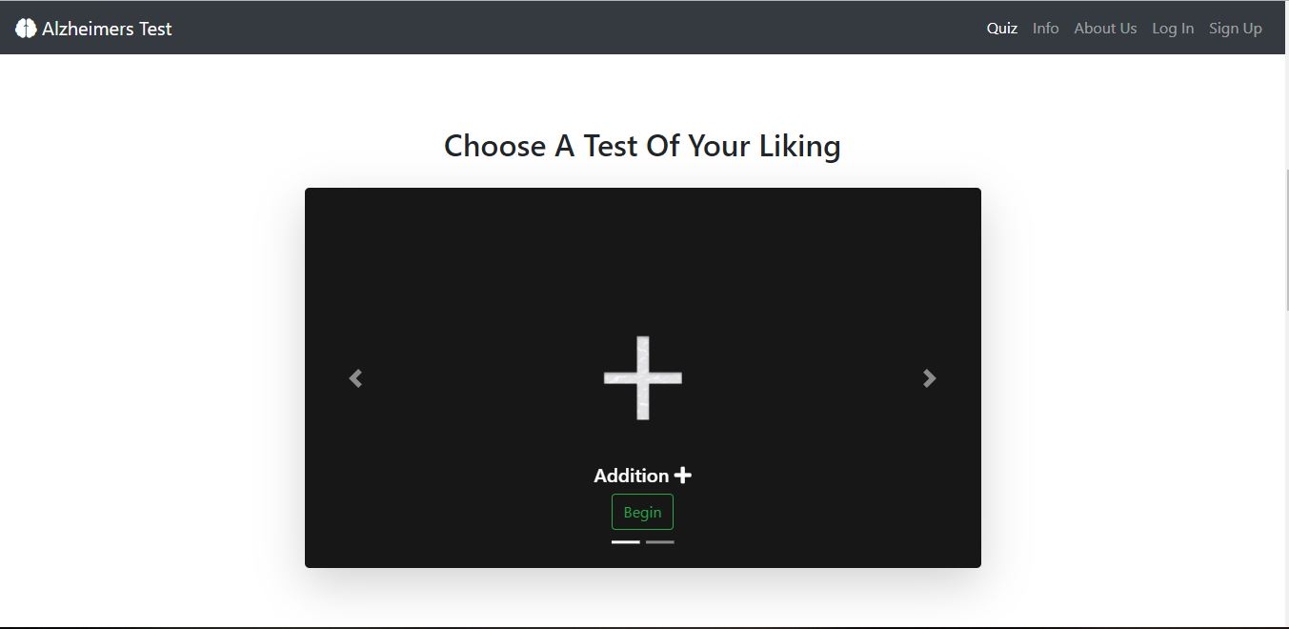
DESIGN

Slide 6
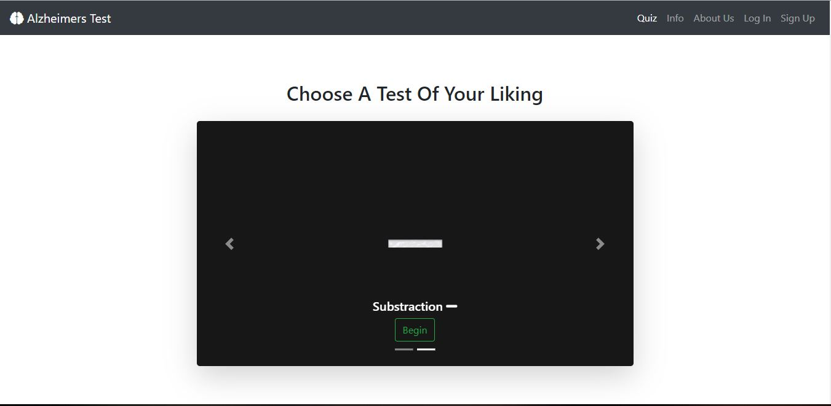
DESIGN

Slide 7
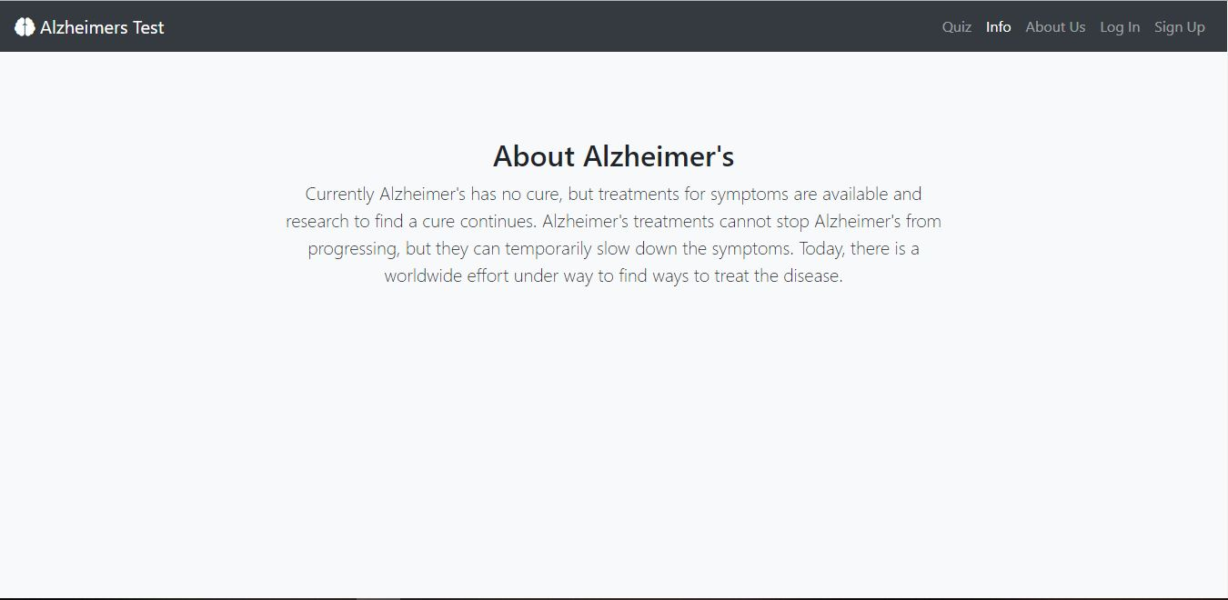
DESIGN

Slide 8

DESIGN

Slide 9

DESIGN

Slide 10
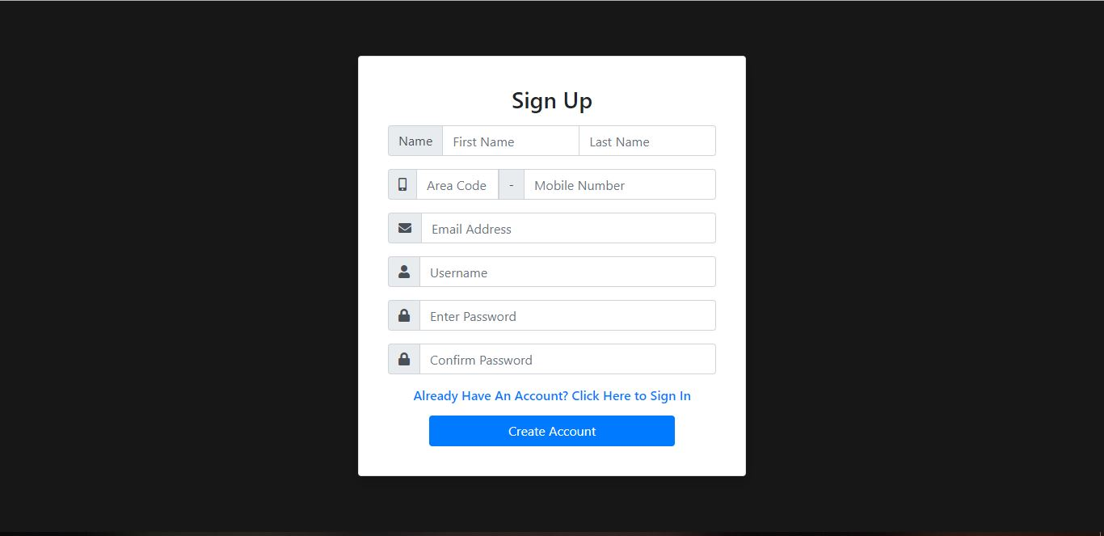
DESIGN

Slide 11
FUNCTIONALITIES
Addition & Subtraction quiz.
Contact Us
Information on Alzheimer’s disease
Login
Sign up

Slide 12
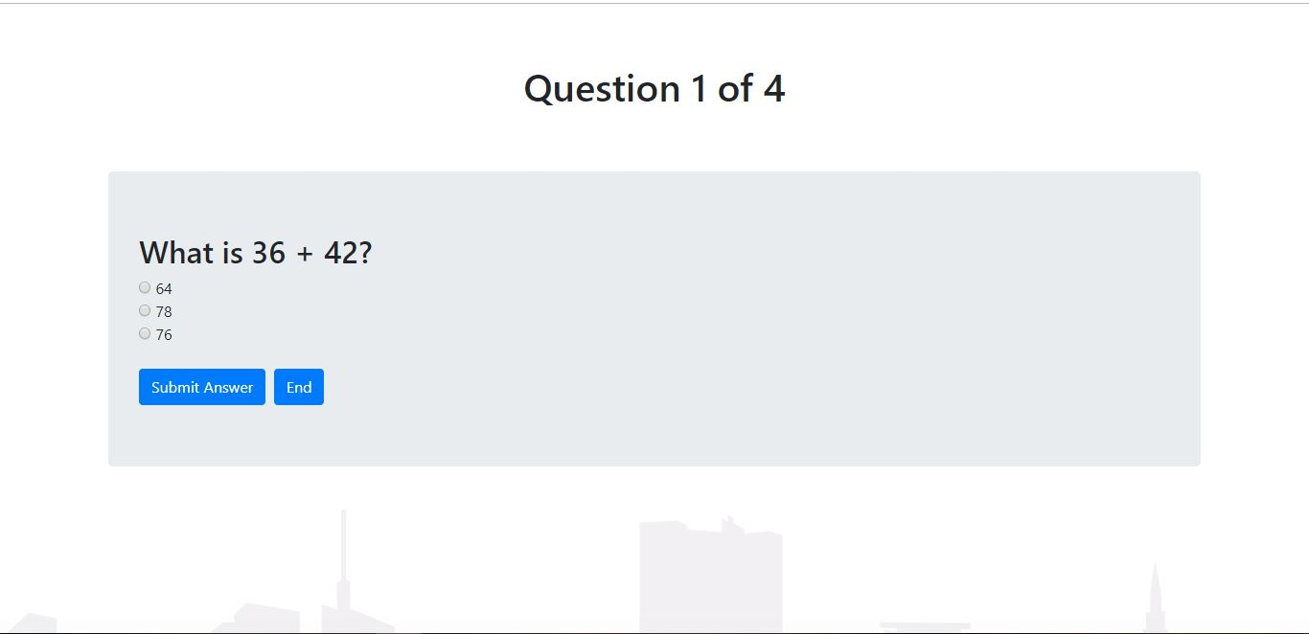
QUIZ QUESTIONS

Slide 13
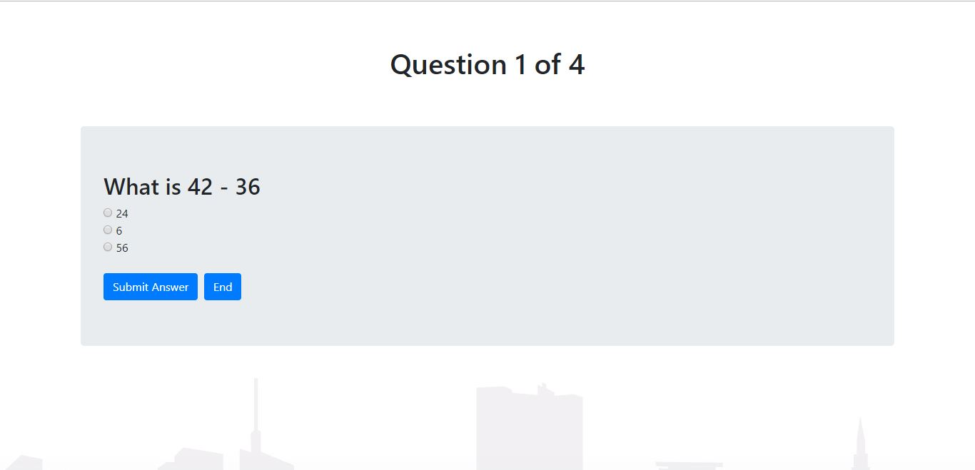
QUIZ QUESTIONS

Slide 14
CONCLUSION
As a closure, we hope to achieve an environment where everyone is aware of how critical and dangerous this Alzheimer’s disease and other dementias as possible. There are six pillars of Alzheimer’s prevention which is regular exercises, social engangement, healthy diet, quality sleep, stress mangement and mental stimulation. We hope through playing our game more or less we manage to trigger their mental stimulation.

